Slide 1
Term Project Guidelines
Instructor: Yang Xu
Partially contributed by Xiaobai Liu

Slide 2
Goals
Complete a project using the Machine Learning techniques you have learned.
Through the project, you:
Get familiar with the common pipelines of ML tasks
Gain hands-on experience on state-of-the-art techniques
Write up a deliverable report

Slide 3
Project Topic
You are encouraged to propose Machine Learning Problems according to your interests or background.
You are strongly encouraged to meet your professor to clarify the problems you have or you might have. This is not required though.
You might also choose one of the recommended topics, enclosed in the end of this slides.

Slide 4
Team
You are encouraged to team up with other student;
No more than 6 members in one team;
For grading, each team need to submit one evaluation package including: source code, report, and statements of author contributions
Example
model.py
report.pdf
statement.doc
Readme.md

Slide 5
Evaluation (100%)
Report (60%)
Code (40%)
Well documented and commented
Executable; free of bugs

Slide 6
Evaluation - Report
Up to 5 to 8 pages excluding reference (12 fonts, single-line space, two-sides)
Template files will be provided in both LATEX and Word
Structure
Title
Abstract: 100-300 words
Introduction
Task Description
Major challenges and solutions
Methods and Results
Data and models (Details about parameters, hyperparameters etc.)
Evaluation metrics (Compare several models, or with previous studies if possible)
Analysis and discussion (Discuss why your model works)
Conclusion and Future works

Slide 7
Evaluation - Report (cont.)
Grading will be done based on the following factors
System design
Model Design
Training algorithm
Testing and Evaluation
Result Analysis
Figures/visualization
Your efforts…

Slide 8
Evaluation: Code
All source code submitted should be free of bugs (can run without errors)
Raw Python code or Jupyter Notebook are acceptable
Self-contained: include and cite the third-party software packages
A README.md file is preferred
A Github repo is even better

Slide 9
Project Resources
It is strongly recommended to follow your own interests/background to set up the project.
But you can also use these public datasets as shown in the next slides

Slide 10
1. UCI Machine Learning Repository
https://archive.ics.uci.edu/ml/datasets.html
335 datasets with data, instructions, and probably baseline methods
Cover life sciences ,physical sciences, CS, Business, Game etc.
Data are provided in Numerical or categorical

Slide 11
1.1 CANE-9
Link: https://archive.ics.uci.edu/ml/datasets/CNAE-9
Descriptions: containing 1080 documents; each document describes one company;
Features: 857 words and their frequency
Task: to classify company into 9 categories;

Slide 12
1.2.SMS spam collection dataset
Link: https://archive.ics.uci.edu/ml/datasets/SMS+Spam+Collection
Descriptions : set of 5574 SMS labeled messages that have been collected for mobile phone spam research.
Features: unknown number of words (extract on your own)
Task: classify email to be spam or ham

Slide 13
1.3. Sentiment Labelled Sentences
Link:https://archive.ics.uci.edu/ml/datasets/Sentiment+Labelled+Sentences
Descriptions : contains sentences labelled with positive or negative sentiment; sentences come from three different websites/fields: imdb.com ; amazon.com ; yelp.com; no neutral sentences to be selected.
Features: unknown number of words (extract on your own)
Task: classify one sentence (tweet) to be Positive (happy) or Negative (unhappy)

Slide 14
1.4. Student performance dataset
https://archive.ics.uci.edu/ml/datasets/Student+Performance
Descriptions: approach student achievement in secondary education of two Portuguese schools
Features: include student grades, demographic, social and school related features
Task: predict student performance (G1,G2,G3) in secondary education (high school).

Slide 15
1.5: Bike sharing dataset
https://archive.ics.uci.edu/ml/datasets/Bike+Sharing+Dataset
Descriptions: contains the hourly and daily count of rental bikes between years 2011 and 2012 in Capital bike share system with the corresponding weather and seasonal information.
Features: 16, e.g. date, season, year, month, hour, holiday, weekday, etc. and count of total rental bikes
Task: regression, predict counts of rental bikes.

Slide 16
2. Text datasets
http://www.cad.zju.edu.cn/home/dengcai/Data/TextData.html
TDT2: 11201 on-topic documents which are classified into 96 semantic categories
Reuters-21578: 21578 documents in 135 categories
Newsgroups: 18846 documents from 20 newsgroup;
Task: Classification
Features and labels available

Slide 17
3. Face datasets
http://www.cad.zju.edu.cn/home/dengcai/Data/FaceData.html
Yale Dataset: 165 gray-scale images of 15 persons
Orl Dataset: 400 images of 40 persons
Yale-B: 2414 images of 38 persons
Tasks: clustering; classification
Features and labels available

Slide 18
4. Kaggle Datasets
https://www.kaggle.com/datasets

Slide 19
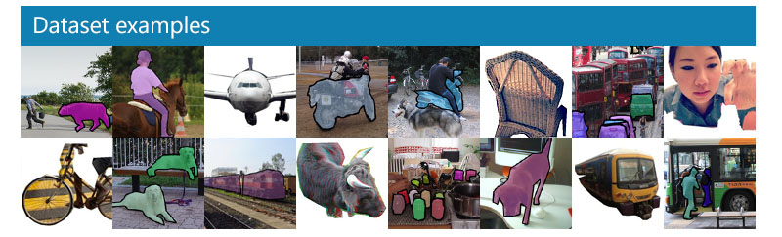
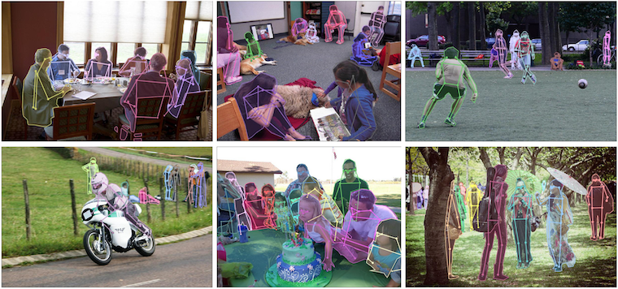
5. Microsoft COCO Competition
http://cocodataset.org/#home
Object Detection
Keypoint Detection [Demo]

Slide 20
6. CIFAR-10, CIFAR-100
https://www.cs.toronto.edu/~kriz/cifar.html
The CIFAR-10 dataset consists of 60000 32x32 colour images in 10 classes, with 6000 images per class

